Slide 1
SUBMITTED BY:
AJAY MAHARJAN (HCE075BCT006)
ASHISH RAI (HCE075BCT042)
NIBENDRA BAJRACHARYA (HCE075BCT015)
SUJAN MAHARJAN (HCE075BCT037)
A FINAL YEAR MAJOR PROJECT
ON
IMAGE INPAINTING USING GENERATIVE ADVERSARIAL NETWORKS (GAN)
[CT 707]
SUBMITTED TO:
DEPARTMENT OF ELECTRONICS AND COMPUTER ENGINEERING

Slide 2
Introduction
Image Inpainting underlie Image Processing using deep learning technique.
Improve the quality of an images
Recover the lost fragment or remove the object completely.

Slide 3
Problem Statement
Difficult to restore or recover corrupt image.
Requires photoshop skills which is a tedious process.

Slide 4
Objectives
To implement Generative and Adversarial Network more focused on Pix2Pix.
To develop web-app for restoring old or corrupted photographs.

Slide 5
Scope and Applications
To reconstitute the missing or damaged portions of the work.
To edit an image i.e object removal.

Slide 6
Requirement Analysis
Functional Requirements:
Login/Register
Upload images
Image restoration
Download image

Slide 7
Non-Functional Requirements:
Reliable
Availability
Performance
Scalability
Maintainability
Security

Slide 8
Feasibility Study
Technical Feasibility - Hardware and software tools are within accessible boundaries.
Operational Feasibility - Simple and interactive interface and data drive.
Economic Feasibility - Only a computer is required to access the web application

Slide 9
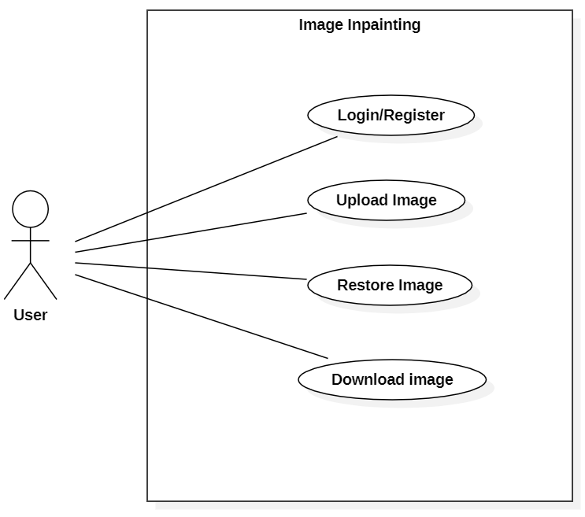
System Design
Use Case Diagram

Slide 10
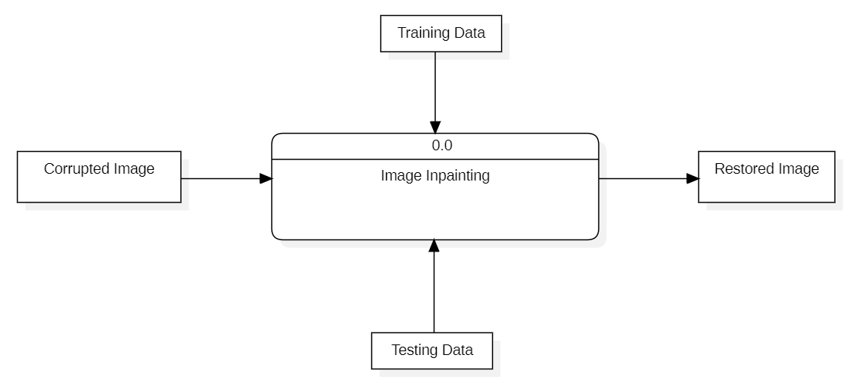
Data Flow Diagram Level 0

Slide 11
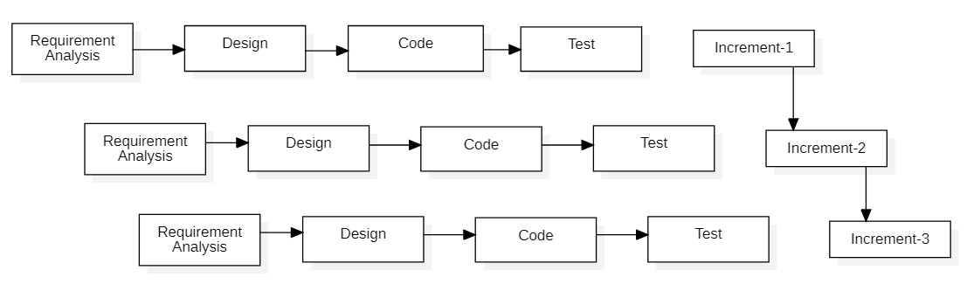
Methodology
Fig : Block diagram of incremental model

Slide 12
Image Inpainting
The main objective is to implement the GAN for image inpainting.
In GAN, two models are simultaneously trained:
Generator - Captures data distribution and generates images
Discriminator – Estimates the probability that a sample came from training data rather than the Generator.
Corresponds to a minimax two player game

Slide 13
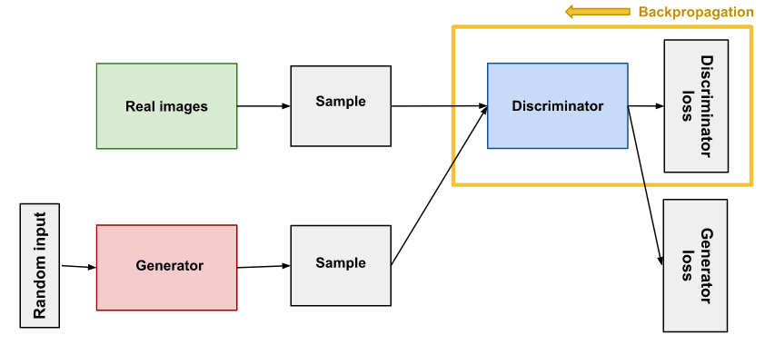

Slide 14
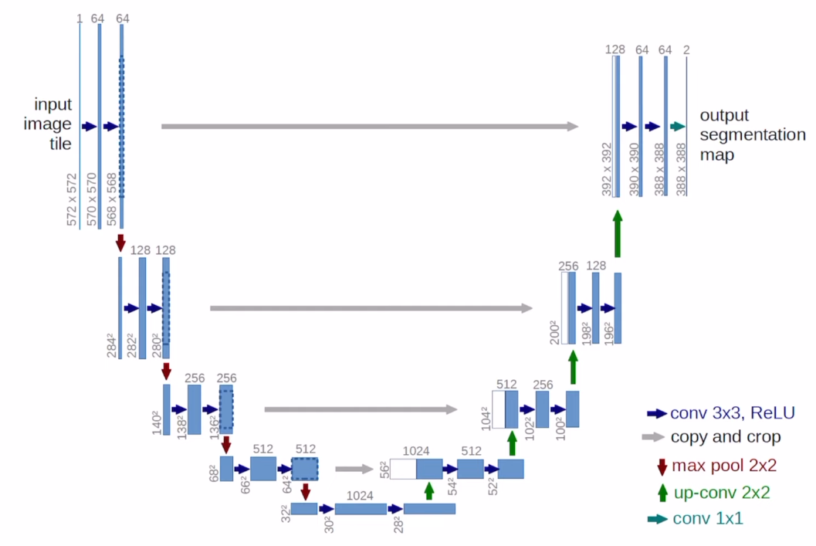
Generator

Slide 15
The network architecture of the generator is based on U-Net, which is certain kind of architecture that achieves image segmentation.
The generator consists of the convolutional layers in encoder-decoder fashion, that generates the recovered images from cropped images.
The left side of the network is Contracting path or Encoder.
The right side of the network is Expansive path or Decoder.
The generated image of the generator is then injected into the discriminator, that determines whether the image is real or fake.

Slide 16
Each block in the encoder is: Convolution -> Batch normalization -> Leaky ReLU
Each block in the decoder is: Transposed convolution -> Batch normalization -> Dropout (applied to the first 3 blocks) -> ReLU
Skip connections between the encoder and decoder.

Slide 17
Generator loss
The generator loss is a sigmoid cross-entropy loss of the generated images and an array of ones.
Also includes L1 loss, which is MAE (mean absolute error) between the generated image and the target image.

Slide 18
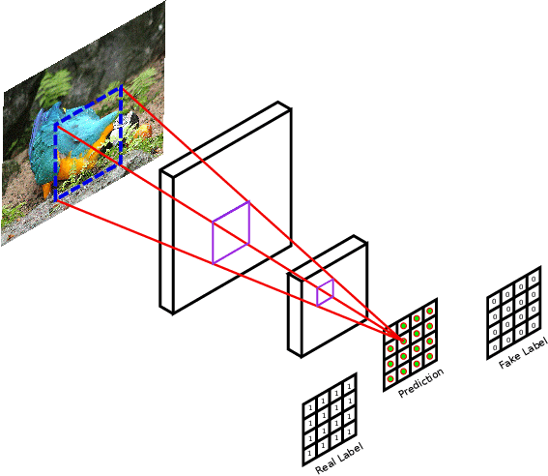
Discriminator

Slide 19
PatchGAN classifier—it tries to classify if each image patch is real or not real.
Run this discriminator convolutionally across the image, averaging all responses to provide the ultimate output of D.
Each value of the output matrix represents the probability of whether the corresponding image patch is real or artiﬁcially generated.

Slide 20
The discriminator receives 2 inputs:
The input image and the target image, which it should classify as real.
The input image and the generated image (the output of the generator), which it should classify as fake.
Each block in the discriminator is: Convolution -> Batch normalization -> Leaky ReLU.
The shape of the output after the last layer is (batch_size, 30, 30, 1).
Each 30 x 30 image patch of the output classifies a 70 x 70 portion of the input image.

Slide 21
Discriminator loss
The discriminator loss function takes 2 inputs: real images and generated images.
Real loss is a sigmoid cross-entropy loss of the real images and an array of ones.
Generated loss is a sigmoid cross-entropy loss of the generated images and an array of zeros.
Total loss is the sum of real loss and generated loss.

Slide 22
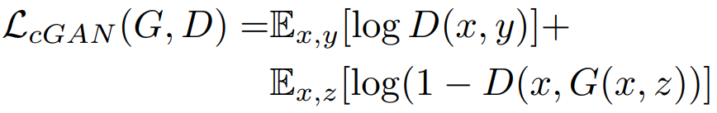

Minimax loss:
Mean Absolute Error (L1 loss) :
Final objective function:

Slide 23
Frontend development:
JavaScript – React
CSS
Backend development:
Node JS
Python

Slide 24
Tasks completed
A homepage showcasing the basic functionality of our application has been created.
Reviewed some research papers on GAN models used for image inpainting.
Obtained “places” dataset and prepared the data in a suitable form to train the model.

Slide 25
Tasks remaining
Dynamic properties of the web application need to be added.
GAN model with the corresponding generator and discriminator needs to be built.
Customizing the model to increase accuracy.
Building database, creating APIs.

Slide 26
References
[1] S. Salve, T. Shah, V. Ranjane, and S. Sadhukhan, "Automatization of coloring grayscale images using convolutional neural network," 2018.
[2] V. K. Putri and M. I. Fanany, "Sketch plus colorization deep convolutional neural networks for photos generation from sketches," pp. 1-6, 2017.
[3] H. H. Chen Y, "An improved method for semantic image inpainting with gans: progressive inpainting.," Neural Process Lett, p. 1355–1367, 2019.
[4] Vitoria P, Sintes J, Ballester C, "Semantic image inpainting through improved Wasserstein generative adversarial networks," 2018.
[5] Nazeri K, Ng E, Joseph T, Qureshi F, Ebrahimi M, "Edgeconnect: generative image inpainting with adversarial edge learning," 2019.
[6] Yuan L, Ruan C, Hu H, Chen D, "Image inpainting based on patch-GANs," 2019.

Slide 27
Thank You

